Slide 1
BOOTING PROCESS IN A COMPUTER

Slide 2
MEANING OF BOOTING.
What is booting?
Booting refers to the process of turning on a computer and starting the operating system.

Slide 3
TYPES OF BOOTING.
There are two types of booting namely:
Cold booting.
Warm booting

Slide 4
WHAT IS COLD BOOTING?
Cold booting is the process of turning on a computer after it was turned off completely.

Slide 5
WHAT IS WARM BOOTING?
warm booting is the process of turning on a computer after it was restarted.
For example, in changing some system setting the OS require user to restart ( apply warm booting ) so as to apply the saved changes.

Slide 6
BOOTING PROCESS OF A COMPUTER.
There are six steps involved when booting a computer.
BIOS AND SETUP PROGRAM.
THE POWER ON SELF TEST.
LOADING OPERATING SYSTEM.
SYSTEM CONFIGURATION.
SYSTEM UTILITY LOADS .
USER AUTHENTICATION.

Slide 7
BIOS AND SETUP PROGRAM.
After turning pressing power button,the CPU has no software in its main memory so some process must be sunned before it can be executed by CPU register.
Here the CPU register looks for BIOS located in ROM and start executing it. ROM loads BIOS into computer main memory(RAM).

Slide 8
Cont...
BIOS is the part of system software that includes instructions which the computer use to understand input and output.
while BIOS info is visible, program setup can be accessed to control hardware.

Slide 9
2. THE POWER ON SELF TEST (POST).
After BIOS is completely loaded it performs multiple power test to check components like computer’s main memory and input/output
system.
This checks for input/output penetrability.So, if POST succeeds, the computer loads partition table into a RAM. And if the POST fails,booting halts( makes beeping sound and error message is displayed on the monitor.

Slide 10
3. LOADING OPERATING SYSTEM(OS).
After the POST succeeds, then the BIOS looks for OS in the ROM. This is done by CMOS(Complementary Metal Oxide Semiconductor) which knows where to look for OS.In window, OS is located at local disk C.
In this step, the computer kernel’s is loaded into computer’s memory.

Slide 11
CONT...
The operating system takes control of the computer and begin loading system configuration information.

Slide 12
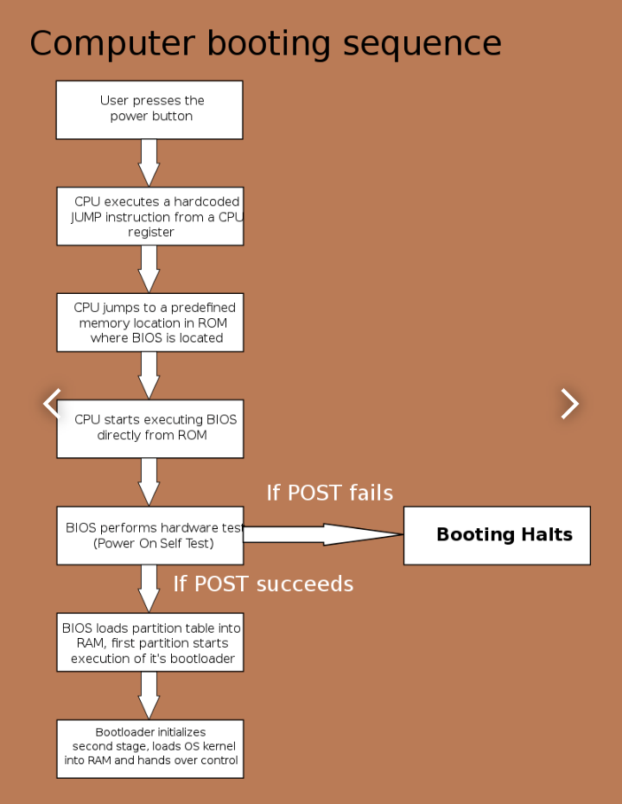
THE FIGURE SHOWING BOOTING STEPS.

Slide 13
4.SYSTEM CONFIGURATION.
Following this, system configures drivers installed in the computer OS.
The database storing settings and configurations is initialized.
Then, drivers necessary for peripherals are loaded.These drivers allow functioning of peripherals.

Slide 14
5.SYSTEM UTILITIES LOADS.
After configurations and registry, the system utilities like anti-virus,PC card unplugging and volume control utilities are loaded into computer’s memory.
These utilities enhances system performance, security and user experience.

Slide 15
6.USER AUTHENTICATION.
This is the last step before user starts to interact with the computer.
The system prompts the user for authentication (requesting username and password).
If authentication succeeds,the user interface is then initiated, allowing users to interact with the computer and its programs.

Slide 16
CONCLUSION.
Through this,the computer transition from a powered off state to the state where the OS is fully loaded and ready for user interaction.
This steps ensures systematic and orderly startup of the OS, enabling a smooth transition from hardware initialization to user accessibility.

Slide 17
** THE END**
THANK YOU.

